Slide 1


Automated Visiting Card Management Application
Suryanarayanan.S
212221220053

Slide 2
Abstract
The "Automated Visiting Card Management Application" is a comprehensive solution designed to alleviate the challenges associated with manual contact management. Leveraging the power of OpenCV, Tesseract OCR, and Python programming, the application seamlessly captures visiting cards through device cameras. The extracted text, including brand names and details, is processed with high accuracy using Tesseract OCR. The distinguishing feature lies in the automatic alphabetical sorting of captured cards, enhancing the efficiency of contact organization. This project provides a user-friendly and time-saving solution for professionals seeking an automated approach to streamline their business contact management processes.

Slide 3
Literature Review
Sno. | Reference Paper | Author(s) name | Abstract | Year
1.) | ID Card Storage System using Optical Character Recognition (OCR) on Android-based Smartphone | -Jeklin Harefa -Alexander -Andry Chowanda -Emir Haikal -Fedrick | This research focuses on extracting the ID card image characters into an editable format by implementing the Optical Character Recognition (OCR) in the mobile platform (the average is 43 words). | 2022
2.) | Using Image Processing and Optical Character Recognition to Recognise ID cards in the Online Process of Onboarding | -Bektemyssova Gulnara -Akhmer Yerassyl | In this research, we realized an approach for identifying electronic ID cards using image detection and Optical Character Recognition (OCR). This paper provides a short outline of how banking institutions and other fintech companies utilize highly developed OCR tools to automate their processes. | 2022

Slide 4
Sno. | Reference Paper | Author(s) Name | Abstract | Year
3.) | Hybrid Approach to Adaptive OCR for Historical Books | -Vladimir Kluzner -Asaf Tzadok -Dan Chevion -Eugene Walach | Optical character recognition (OCR) technology is widely used to convert scanned documents to text. However, historical books still remain a challenge for state-of-the-art OCR engines. This work proposes a new approach to the OCR of large bodies of text by creating an adaptive mechanism that adjusts itself to each text being processed. | 2011
4.) | Gray-scale character image recognition based on fuzzy DCT transform features | -Xuewen Wang -Xiaoqing Ding -Changsong Liu | We propose a method for recognizing gray-scale text images with noise and of extraordinary low resolution. First, a fuzzy classification of pixels in the gray-scale character images is applied to form the fuzzy attributed pixel graph using integral ratio techniques. | 2000

Slide 5
Problem Statement
Manually entering contact details from business cards is a time-consuming and error-prone task, leading to disorganized and hard-to-access information. The lack of an efficient system for sorting and managing these cards hinders professionals in maintaining an up-to-date and easily searchable digital contact list. This project aims to simplify and automate the process by developing an "Automated Visiting Card Management Application" using computer vision and OCR technologies. The goal is to provide a user-friendly solution that captures, extracts, and organizes business card data, eliminating the need for manual data entry and enhancing the overall efficiency of contact management.

Slide 6
Proposed Solution
The "Automated Visiting Card Management Application" aims to simplify the process of capturing, organizing, and managing business cards. The proposed solution involves the development of a user-friendly mobile application by using the device camera to capture images of visiting cards.
The proposed solution aims to provide professionals with a hassle-free and efficient tool for managing their business contacts. By automating the capture and organization of visiting cards, the application seeks to save time, reduce errors, and enhance the overall user experience in the realm of contact management.

Slide 7
Scope
The project of capturing visiting cards and extracting information from them has several potential scopes, ranging from a simple utility to a more comprehensive application. Here are different scopes for this project:
Basic Information Extraction:
Scope: Capture a visiting card, extract text, and sort the images based on extracted information.
Features: Minimal user interaction, basic OCR, sorting images based on extracted text, and storing them in folders.
Enhanced OCR and Sorting:
Scope: Improve OCR accuracy by implementing advanced preprocessing techniques.
Features: Utilize more sophisticated image preprocessing, multilingual support, and advanced OCR configurations.

Slide 8
Advantages
Efficient Information Handling
Organization and Accessibility
Time Saving
Reduced Data Entry Errors
Mobile Accessibility
Customization and User Preferences

Slide 9
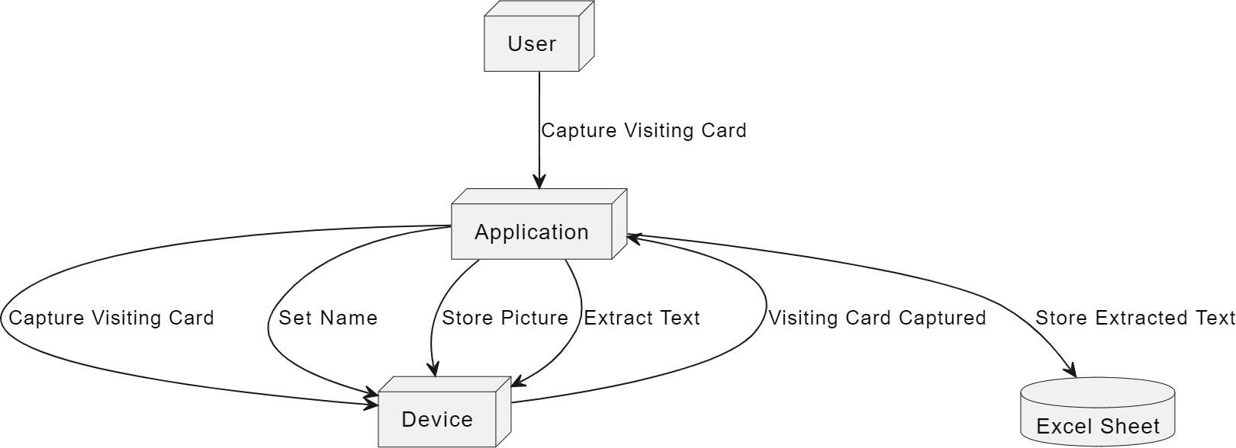
Flowchart

Slide 10
THANK YOU

